Slide 1


BIKE RENTALS
PRESENTATION
~GROUP 2

Slide 2

TEAM MEMBERS
Lagadapati Bhanu Krishna
Nikita Sagar
Gajula Anil Kumar
Shaik Mohammed Sufyaan
Vovia Jagadeesan
Adarsh Sanjivan Waghmare

Slide 3
Objective of the Project
Analyze the myriad factors influencing daily bike rental demand and,
subsequently, to develop a robust predictive model capable of forecasting rental
counts with high accuracy.
Understand how environmental factors like temperature, humidity, wind
speed, and weather conditions impact bike usage.
Analyze seasonal and temporal trends, including monthly, hourly, and
seasonal variations in demand.
Identify key drivers contributing to the total rental count.
Build and compare multiple regression models to determine the most
accurate prediction algorithm.
Provide data-driven insights to optimize inventory planning and operational
decision-making.

Slide 4
Dataset Overview
This section introduces the dataset used for our bike rental demand forecasting project. Sourced from the Repository, this comprehensive dataset captures two years of hourly rental data for a bike-sharing system, providing a rich foundation for our analysis and predictive modeling efforts.
Records
Features
17,379 hourly observations of bike rentals.
16 predictive attributes including environmental, seasonal, and temporal factors.
Time Period
Source
Data spans over 2 years from January 2011 to
December 2012.
Data Repository.

Slide 5

Project Workflow: From Data to Insights
Data Collection
Cleaning
EDA
Feature Eng.
Model Building
The project began with data understanding and exploratory analysis to uncover trends, seasonal
patterns, and feature relationships.
This was followed by feature engineering and preprocessing to prepare the data for the data modeling
and Model comparison.
Finally, multiple regression models were developed, evaluated, and compared to identify the
most accurate and reliable predictive solution.

Slide 6
Project Workflow: From Data to Insights
01
Data Collection
02
Cleaning & Preprocessing
03
Exploratory Data Analysis (EDA)
Gathering raw bike rental data from the source.
Handling missing values, outliers, and formatting data for analysis readiness.
Understanding underlying data patterns, distributions, and inter-relationships.
04
Feature Engineering
05
Model Selection & Training
06
Model Evaluation
Creating new, more informative features from existing data to enhance model performance.
Choosing appropriate machine learning models and training them with the prepared data.
Assessing the trained model's performance and accuracy using various evaluation metrics.
07
Insights & Final Outcome
Deriving actionable insights from the model and presenting the project's conclusions.

Slide 7




Exploratory Data Analysis: Uncovering Trends & Patterns
Data Reliability
Seasonal Dependency
The dataset is robust, showing no significant missing values and a wide range in rental counts, indicating diverse demand levels.
Demand significantly peaks in Summer and Fall, contrasting with lower activity observed during Winter months.
Hourly Commuter Peaks
Progressive Growth
Consistent morning and evening surges in rentals reflect typical commuter-driven usage behavior.
Overall, rental demand shows a progressive increase over time, highlighting growing adoption and utility.

Slide 8
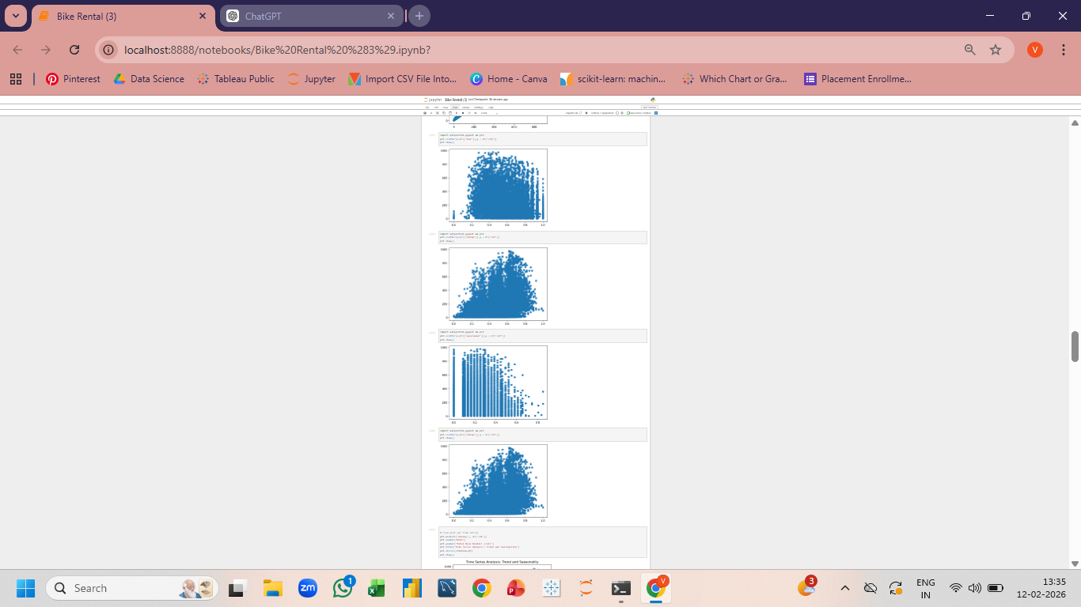
EDA: Feature Impact & Correlation Analysis
Scatter plots and the correlation heatmap clearly indicate strong multicollinearity between temp and atemp, showing overlapping environmental influence observed.
From the correlation heatmap, registered users exhibit the strongest positive relationship with total rentals, establishing them as the most significant predictor.
Bar charts and distribution plots confirm that temperature and weather conditions act as primary external demand drivers, visibly increasing rental counts in favorable conditions.
Visual analysis of scatter plots shows humidity has a moderate negative trend, while windspeed demonstrates a weaker inverse relationship with rental activity.
The chart-based patterns reveal non-linear relationships and correlated predictors, supporting the need for ensemble models capable of handling feature interactions effectively.
The correlation heatmap definitively shows that 'registered' users are the strongest predictor, followed closely by 'temp' and 'atemp', solidifying environmental and temporal variables as dominant drivers.

Slide 9
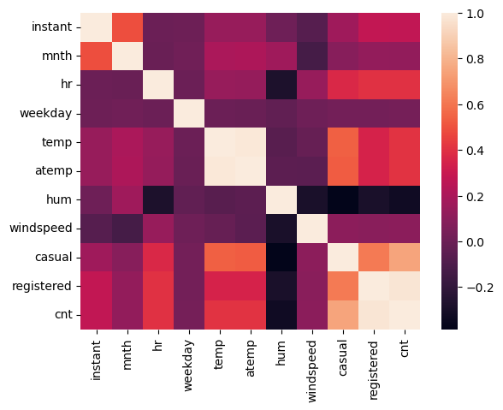
EDA: Relationships & Correlation Insights
Environmental Impact on Demand
Strong positive correlation with rental demand; higher temperatures lead to more rentals.
Clear weather consistently generates maximum rentals, while adverse conditions (rain, snow) significantly reduce demand.
Humidity shows a mild negative impact, and windspeed exhibits a weak to moderate inverse influence on rental numbers.
Key Findings
User Behavior Analysis
Registered vs. Casual Users
Strongest Predictors
Multicollinearity Noted
Registered users contribute significantly more to
the overall bike rental volume than casual users.
Registered users, temp, and atemp are the most significant predictors of bike rental demand.
Moderate multicollinearity between temp atemp requires consideration during model development.
Total Rentals & Registered Users
A strong positive correlation exists between the
number of registered users and total rentals,
underscoring their importance in the demand
model.
Primary Demand Drivers
Demand is primarily driven by environmental conditions, seasonal patterns, and the activity of registered users.

Slide 10
Feature Engineering & Data Preparation
This crucial stage involves meticulously preparing the data to ensure our models learn meaningful patterns and avoid misleading associations.
Predictor Variable Selection
Target Leakage Prevention
Categorical Variable Handling
Train-Test Split
Divided the dataset into distinct training and testing sets, ensuring no data leakage between them, for unbiased model evaluation.
Carefully selected relevant variables, guided by prior correlation analysis and domain expertise, to maximize predictive power.
Excluded variables that could lead to target leakage (e.g., 'casual' and 'registered' users to predict 'total' count) to ensure robust model generalization.
Appropriately encoded categorical variables (e.g., 'season', 'weather') for compatibility with regression models.
This meticulous feature engineering process ensures models learn meaningful patterns instead of noise, leading to more accurate and reliable predictions.

Slide 11
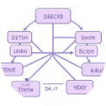




Regression Models Implemented
To identify the most effective predictive algorithm, we deployed and rigorously tested five distinct
regression models. Each model offers a unique approach to understanding and forecasting bike rental
demand.
1. Linear Regression
2. Decision Tree Regressor
3. Random Forest Regressor
An ensemble method using multiple decision trees to improve accuracy and reduce overfitting.
A foundational statistical model, ideal for identifying linear relationships between variables.
A non-linear model that partitions the data space into smaller, more manageable regions.
4. Gradient Boosting Regressor
5. Support Vector Regressor
Another powerful ensemble technique that builds models sequentially, correcting errors of previous models.
A versatile model that identifies an optimal hyperplane to predict continuous values.
Each model was trained on the prepared training dataset and subsequently evaluated on unseen test
data to assess its generalization performance and predictive robustness.

Slide 12
Model Evaluation
Models were rigorously evaluated using industry-standard metrics to ensure a comprehensive understanding of
their predictive capabilities.
Key Observations
Evaluation Metrics
Linear Regression: Performed reasonably but struggled with non-linear patterns, yielding a moderate R² score.
Decision Tree: Captured non-linearity but was prone to overfitting, showing only slight improvement over linear models.
Random Forest: Demonstrated a strong improvement in accuracy with lower RMSE and better generalization, effectively handling non-linearity.
Gradient Boosting: Exhibited high predictive performance, adept at capturing complex feature interactions, typically achieving the highest R².
Support Vector Regressor: Its performance was sensitive to parameter tuning, with effectiveness highly dependent on kernel selection.
MAE (Mean Absolute Error): Represents the
average prediction deviation.
RMSE (Root Mean Squared Error): Penalizes
larger prediction errors more heavily.
R² Score: Measures the proportion of variance in
the dependent variable predictable from the
independent variables.
Ensemble models, such as Random Forest and Gradient Boosting, consistently outperformed simpler
linear models due to their advanced ability to model complex relationships within the data.

Slide 13
Model Performance Comparison & Selection
Model
MAE
RMSE
R²
Decision Tree Regressor
0.03
0.08
0.99
Random Forest Regressor ⭐
0.02
0.06
1.00
Gradient Boosting Regressor
0.03
0.07
0.99
Linear Regression
0.07
0.12
0.99
Support Vector Regressor (SVR)
0.06
0.08
0.99
Final Observations
All regression models achieved exceptionally high R² values (~0.99), indicating strong explanatory power across approaches.
Linear Regression showed comparatively higher error values, suggesting limitations in handling non-linear patterns.
Tree-based models demonstrated better adaptability to complex relationships in the data.
Ensemble methods (Random Forest and Gradient Boosting) consistently produced lower error metrics than individual models.
Random Forest achieved the most balanced and stable performance across all evaluation metrics. The Random Forest model offered the most accurate, stable, and reliable predictions, making it the optimal choice for forecasting bike rental demand.

Slide 14
Why Random Forest Was Selected
Minimal Prediction Error
High Explanatory Power
Achieved the lowest MAE (0.02) and lowest RMSE (0.06), indicating highly accurate predictions.
Recorded the highest R² score (1.00), explaining nearly all variance in rental demand.
Robust Against Overfitting
Captures Non-Linear Relationships
Reduced overfitting by averaging multiple decision trees, providing better generalization than a single Decision Tree model.
Effectively captured complex non-linear relationships identified during EDA, such as temperature, seasonality, and weather impact.
Consistent Performance
Optimal Bias-Variance Trade-off
Delivered consistent performance across both training and testing datasets, ensuring reliability.
Provided a strong balance between bias and variance, leading to a stable and accurate model.

Slide 15
Model Deployment & Prediction
1
2
3
Model Serialization
Application Integration
Real-Time Prediction
The trained Random Forest model was saved using joblib to enable reuse without retraining.
A lightweight interface can be developed using Streamlit.
The deployed model processes input features and generates rental demand predictions instantly.
User inputs suchs as hour, temperature, season, and weather are collected through the interface.
This converts the trained model into a deployable file format.
The output supports demand forecasting and operational decision-making.

Slide 16
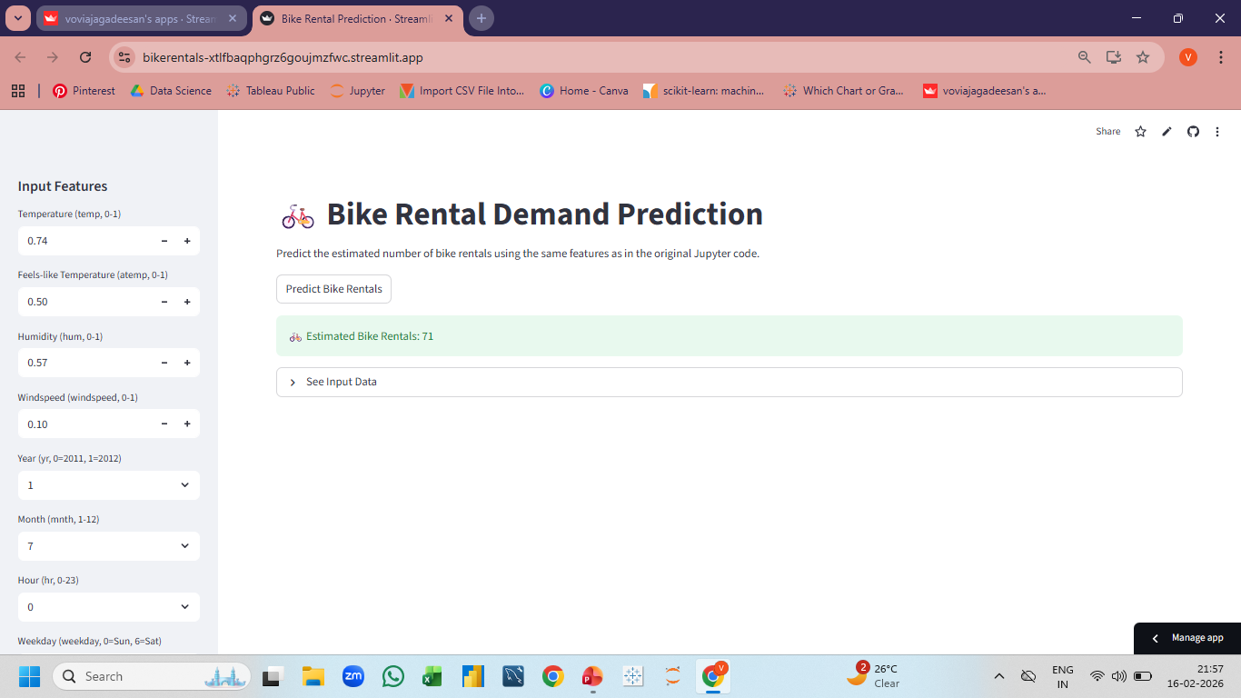

Slide 17
Challenges Faced
During the course of this project, several challenges were encountered and successfully
navigated, enriching our understanding and refining our approach to predictive modeling.
Categorical Variable Management
Avoiding Target Leakage
Properly handling categorical variables to ensure their effective integration into diverse regression models.
Preventing situations where 'casual' and 'registered' user counts could artificially inflate the prediction of 'total' rentals.
Mitigating Multicollinearity
Preventing Overfitting
Addressing the strong multicollinearity between 'temperature' and 'apparent temperature' to ensure robust model coefficients.
Implementing strategies to prevent tree-based models from overfitting the training data, ensuring better generalization.
Evaluation Metric Selection
Ensuring Model Generalization
Choosing the most appropriate evaluation metrics (MAE, RMSE, R²) that accurately reflect model performance for this specific business problem.
Validating that the selected model performs reliably on unseen data, guaranteeing its practical utility in real-world scenarios.

Slide 18
Business Insights from the Predictive Model
Temperature as a Key Driver
Temperature is the strongest environmental factor influencing rental demand, with
higher temperatures correlating directly to increased usage.
Significant Seasonal Impact
Rental patterns are heavily influenced by seasonal variations, necessitating
adaptive inventory and staffing levels throughout the year.
Registered Users: The Core
Registered users form the backbone of the rental system, indicating a stable,
subscriber-based demand that can be leveraged for loyalty programs.

Slide 19
Business Insights from
the Predictive Model
Commuting Hour Peaks
Demand peaks significantly during morning and evening commuting hours,
identifying prime opportunities for strategic bike placement and availability.
Weather-Related Declines
Adverse weather conditions cause noticeable declines in rentals, highlighting
the need for real-time weather integration into operational planning.
Optimized Operations
Predictive modeling can forecast high-demand days, allowing for optimized
inventory management and workforce planning, leading to greater efficiency
and customer satisfaction.

Slide 20

Conclusion & Suggestions
Conclusion
This project successfully analyzed the key factors
influencing bike rental demand and developed a
reliable predictive model.
The Random Forest Regressor consistently
demonstrated the best performance, achieving the
highest R² score and lowest error metrics among the
evaluated models.
Its ability to capture complex non-linear
relationships and seasonal variations highlights the
effectiveness of data-driven modeling in providing
valuable business intelligence for bike
sharing systems.

Slide 21
Conclusion & Suggestions
Future Improvements
Implement advanced hyperparameter tuning
techniques to further optimize model performance.
Develop and deploy the model as a web-based
forecasting tool to enable real-time prediction and
accessibility for operational planning.
Incorporate additional external features such as
public holidays, special events, and weather forecasts
to enhance prediction accuracy.
Explore advanced time-series models for
potentially improved capture of temporal
dependencies.
Establish a continuous retraining mechanism to
update the model with new data, ensuring sustained
accuracy and adaptability to evolving patterns.

Slide 22


